Slide 1

AGE RELATED CHANGES IN REPRESENTATION OF UNCERTAINTY LEADS TO DIFFERENTIAL EMOTION PERCEPTION
Rishi Dey Chowdhury
Brain connectivity, Dynamics and Cognition Lab
SAIDE

Slide 2
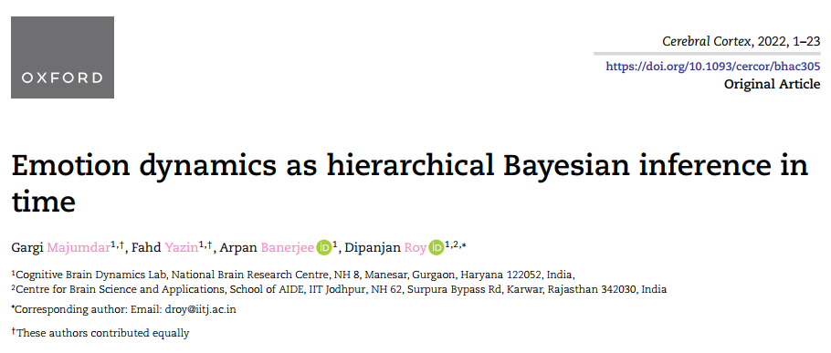
SO FAR..
A predictive framework incorporating uncertainty can explain complex emotions dynamics
(in press)

Slide 3
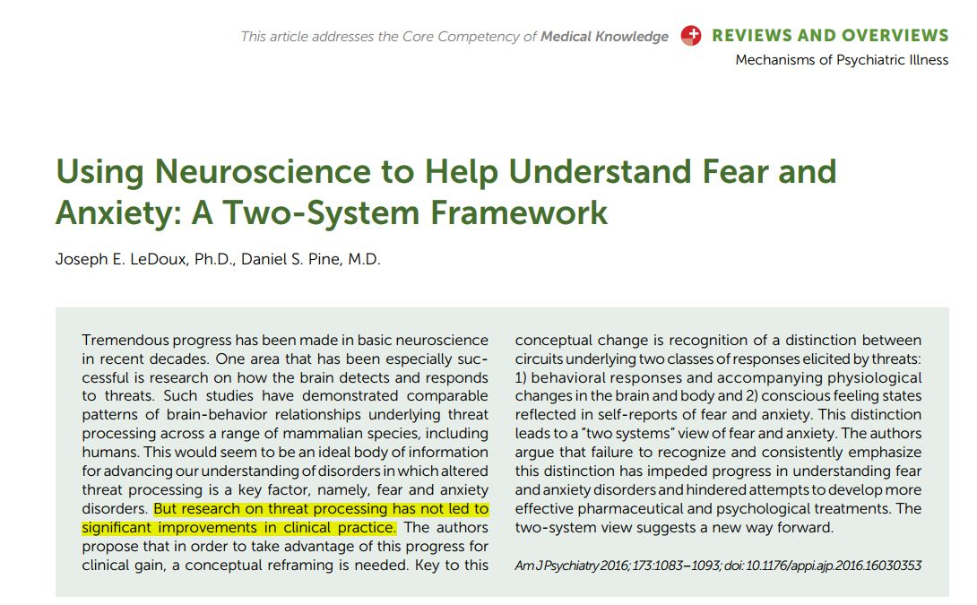
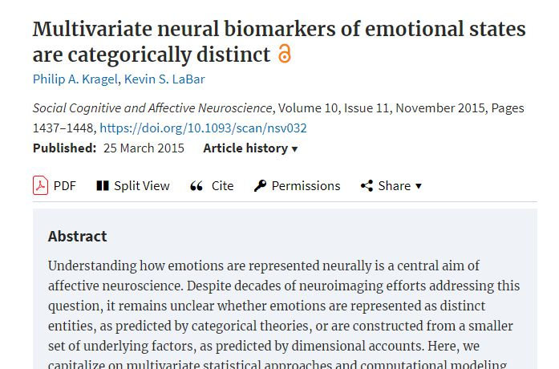
EMOTIONS – AS AROUSAL AND VALENCE
Not enough

Slide 4
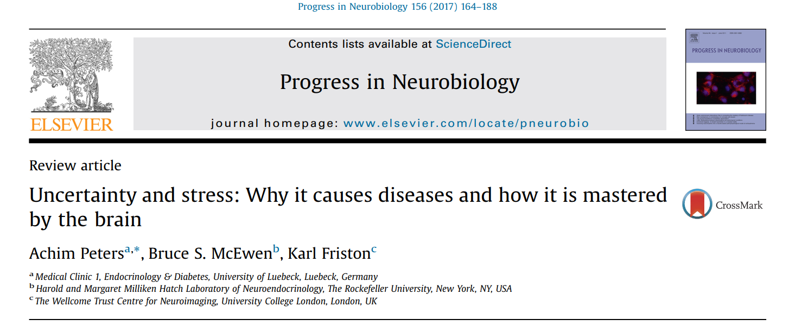
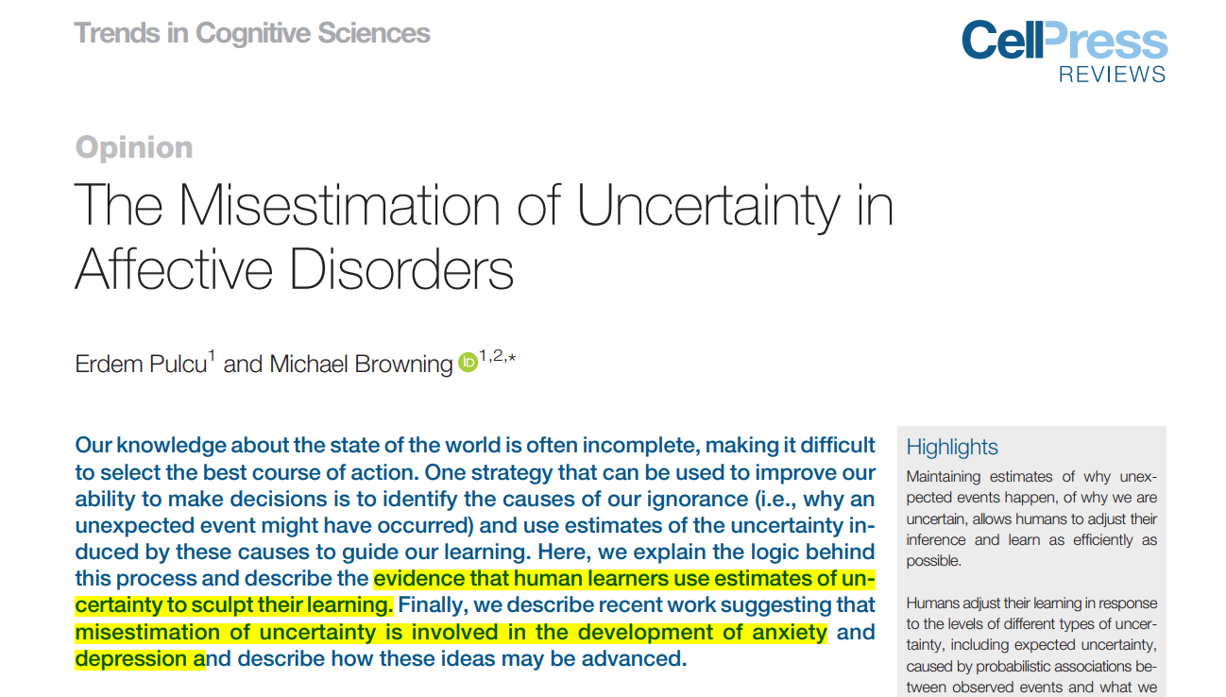

Slide 5
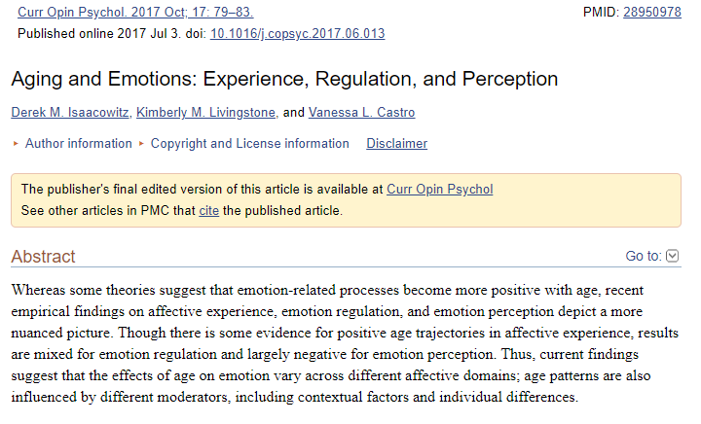
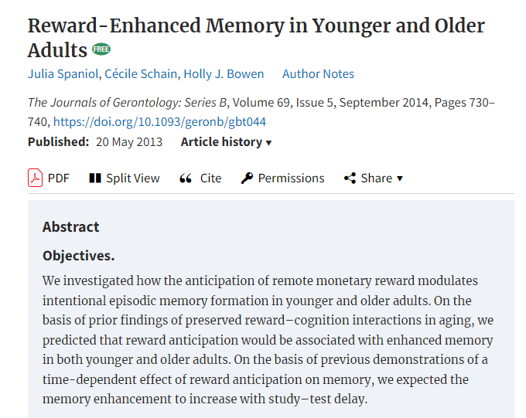
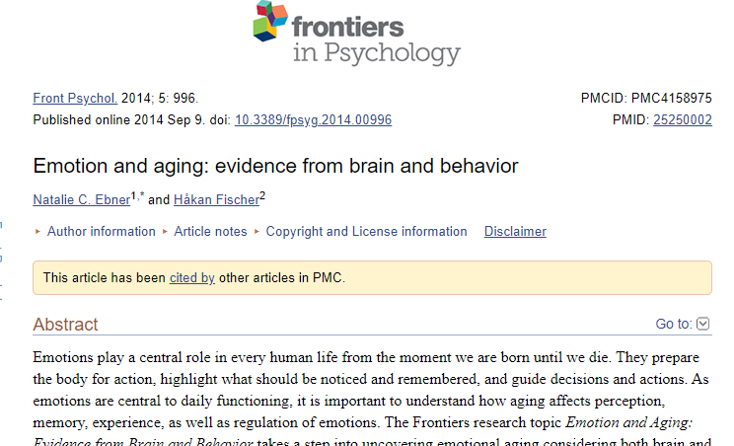
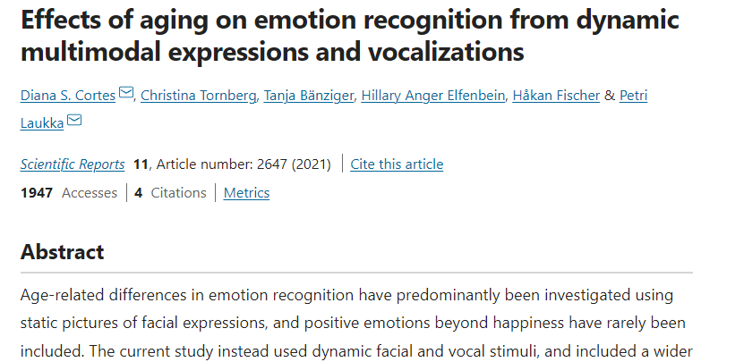
WHAT CHANGES? – THE KNOWN
Contextual nature of differential processing
Differential processing of emotion with age

Slide 6
WHY THE CHANGE? – THE UNKNOWN
Why do older people experience negative emotions differently?

Slide 7
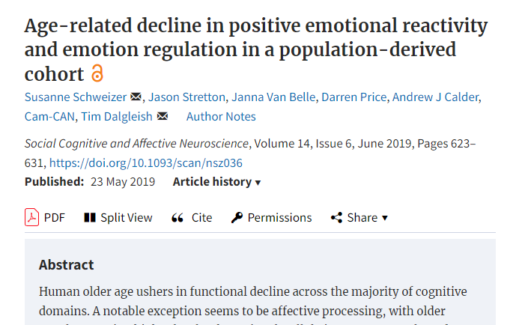
SUSPECT THEORIES
Selective Optimization with Compensation -1995
Dynamic Integration Theory - 2009
Disengagement Theory - 1961
Strength and Vulnerability Integration (SAVI) - 2010
Socioemotional selectivity theory – 1991, 1995
Positivity effect - 2005

Slide 8

Dataset
Young adults
Age:18-35 years (Mean = 27.5)
N = 111
Older adults
Age: 60-88 years (Mean =70)
N = 98

Slide 9
Does older people perceive emotions differently than the young?

Slide 10
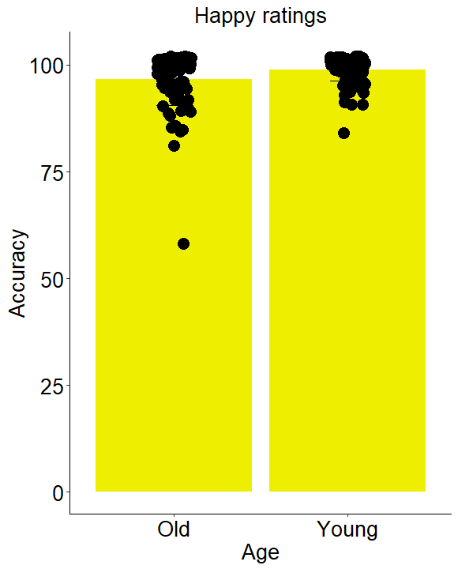
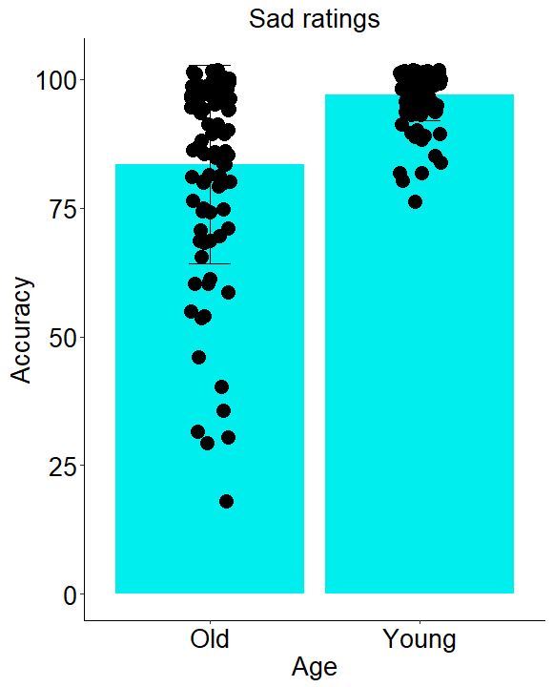
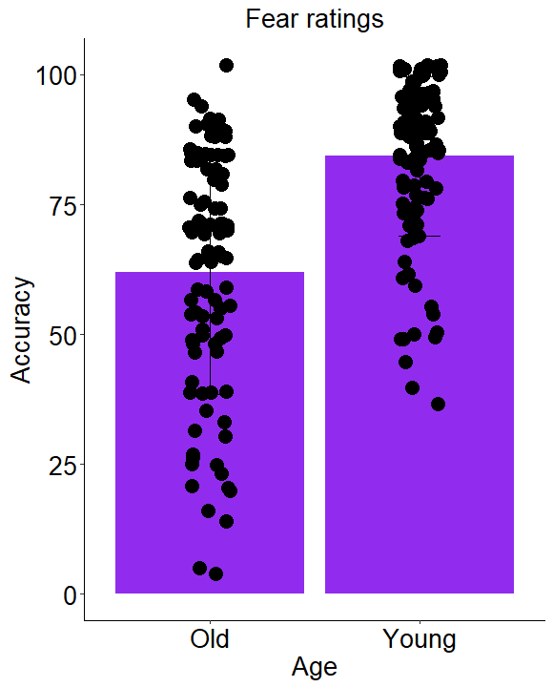
FACIAL EMOTION RECOGNITION

Slide 11
FACIAL EMOTION RECOGNITION
N = 111 (Y)
N = 98 (O)
Happy:
Mean Accuracy: 98%(Y), 96%(O);
P<0.001; Cohen’s d = 0.5
Sad:
Mean Accuracy: 96%(Y), 83%(O);
p<0.0001; Cohen’s d=0.99
Fear:
Mean Accuracy: 84%(Y), 62%(O);
p<0.0001, Cohen’s d = 1.13

Slide 12
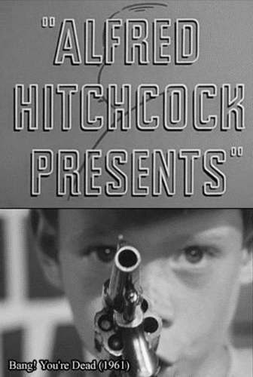
STIMULUS
A suspenseful movie “Bang! You’re dead” (8mins)
Complexity
Social dynamics

Slide 13
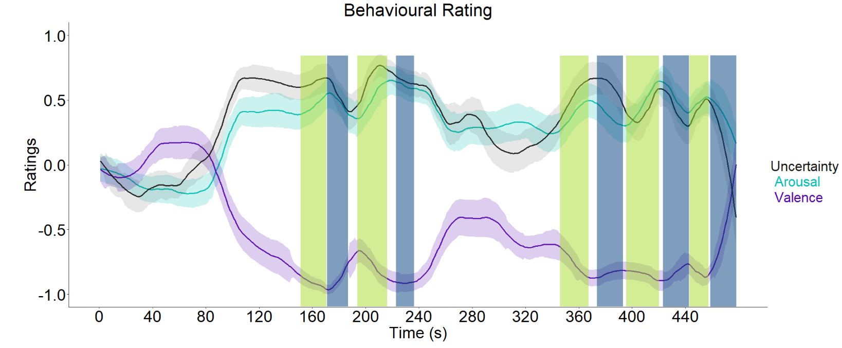
EMOTIONALLY DYNAMIC CONDITIONS
Ascent – 5; Descent – 5; Control – 1

Slide 14
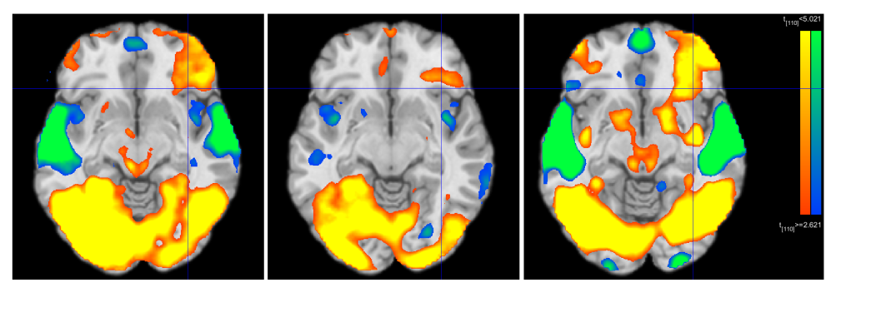
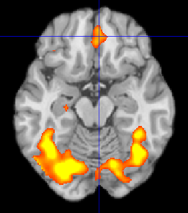
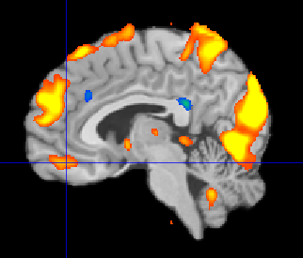
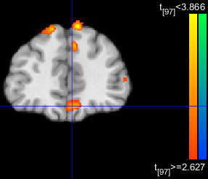
REGIONS OF INTEREST
Ascent > Control
Young
Old
Lateral Orbitofrontal Cortex (lOFC)
More medial activation in Older individuals

Slide 15
Why do older people experience emotion differently compared to young?

Slide 16
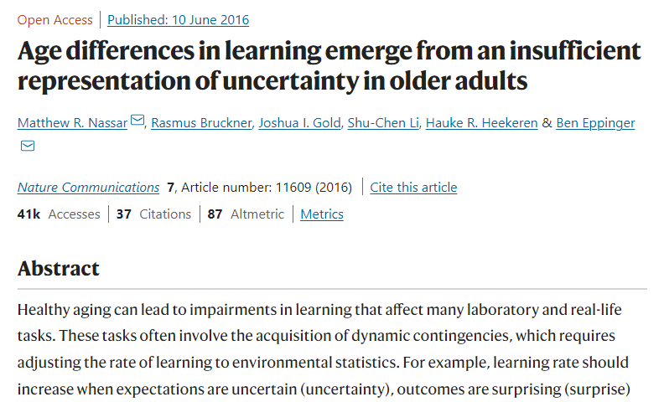
MARR’S LEVEL OF ANALYSIS
Representational level
Computational level
Older individuals have differential representation of uncertainty compared to Young adults
PCA, tSNE, TPHATE

Slide 17
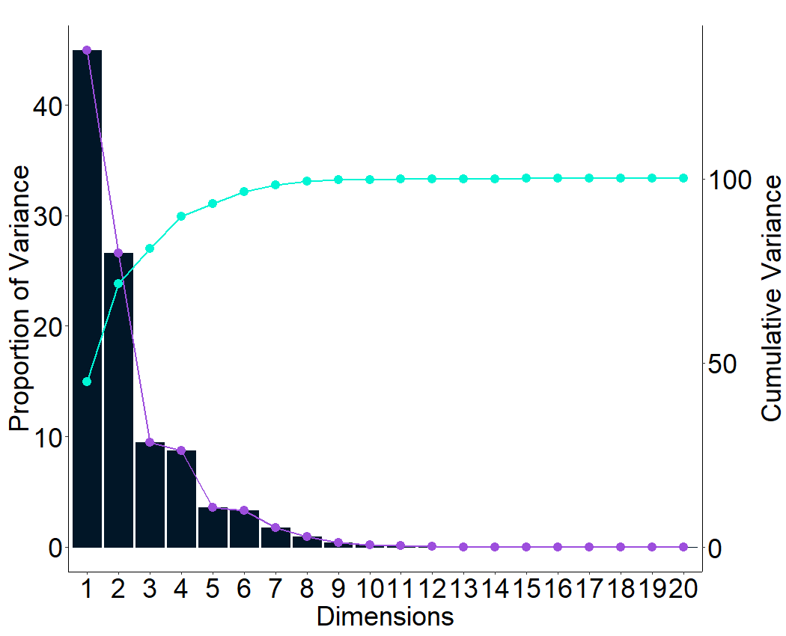
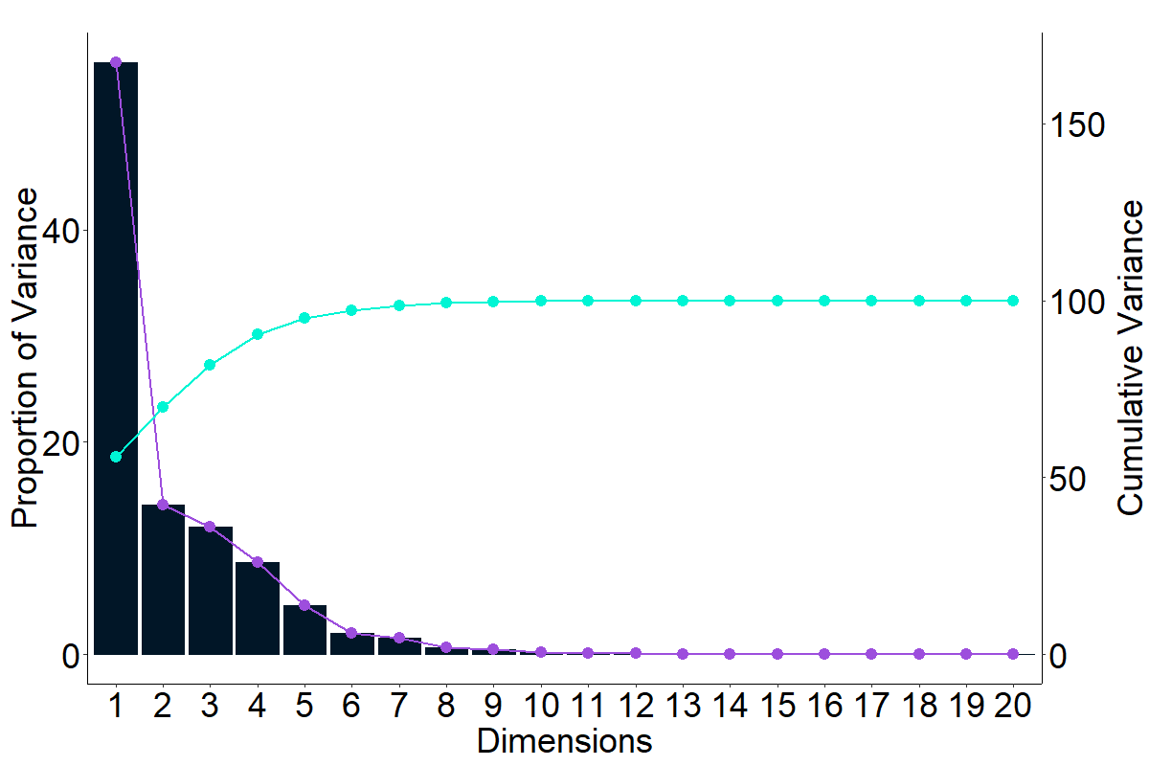
PRINCIPAL COMPONENT ANALYSIS
Young (N=111)
Old (N=98)

Slide 18
PCA
1. The idiosyncratic nature of BOLD activation is observed in Old (validated by ISC – not shown)
2. First 2 components – cumulative variance explained:
Young – 71%
Old – 57.8%

Slide 19
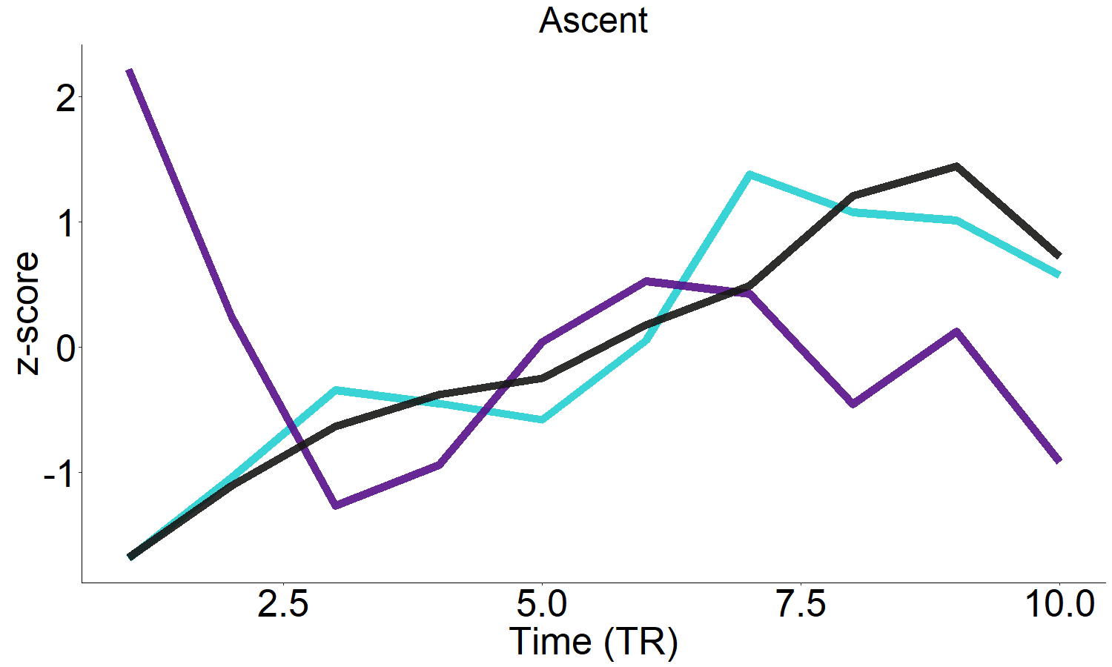
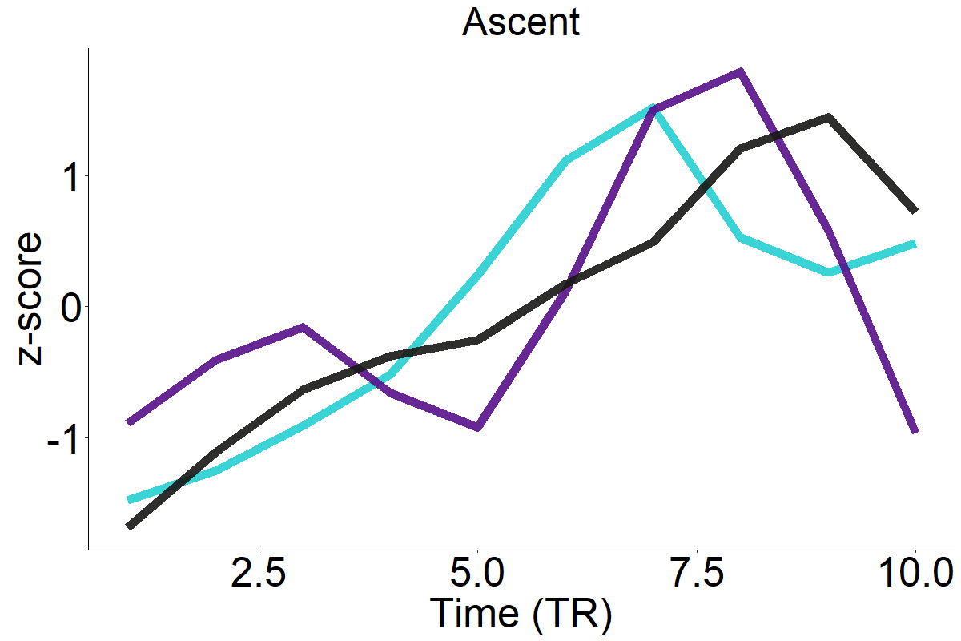
TEMPORAL PCA - PC1
tPC1 – Uncertainty : r = 0.93
tPC1 – Uncertainty : r = 0.76
Young
Old

Slide 20
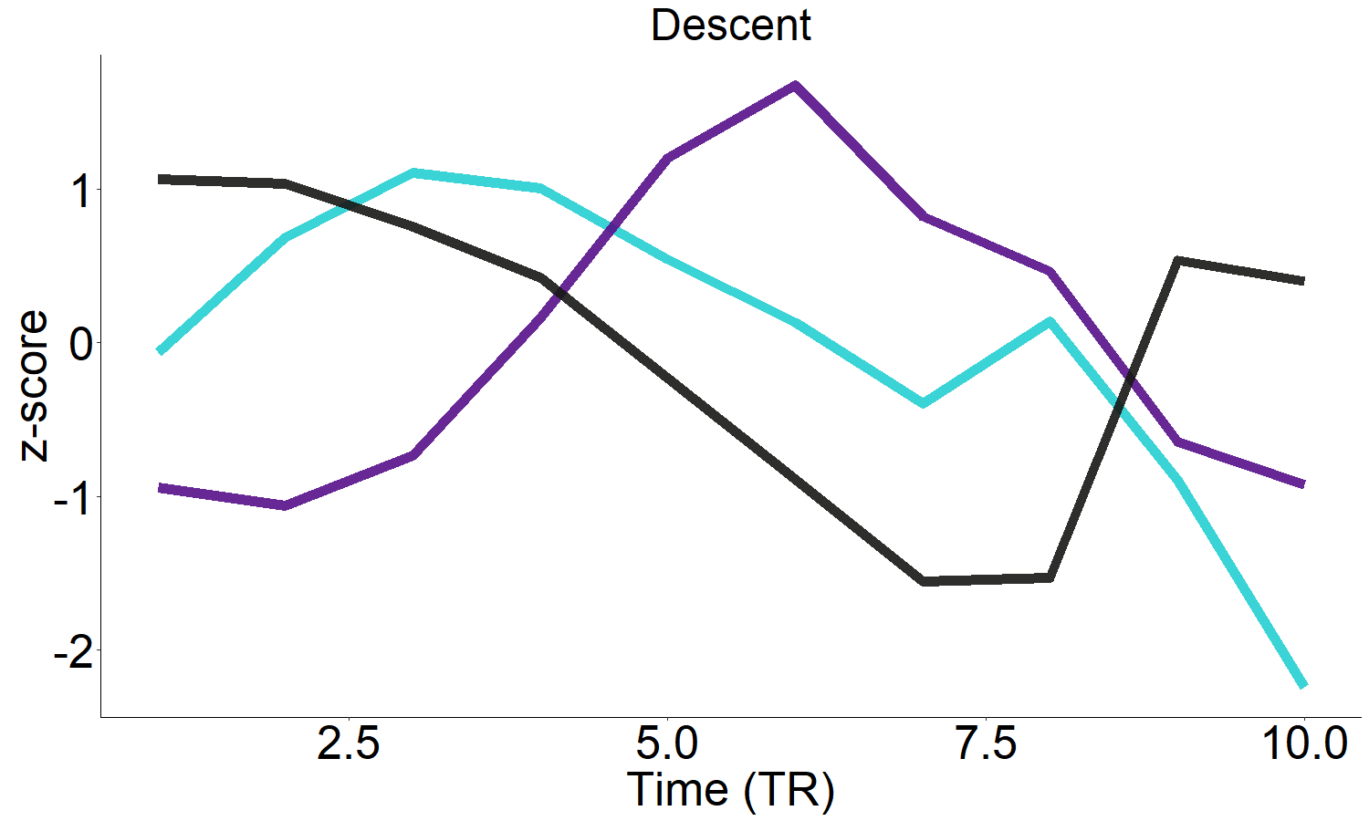
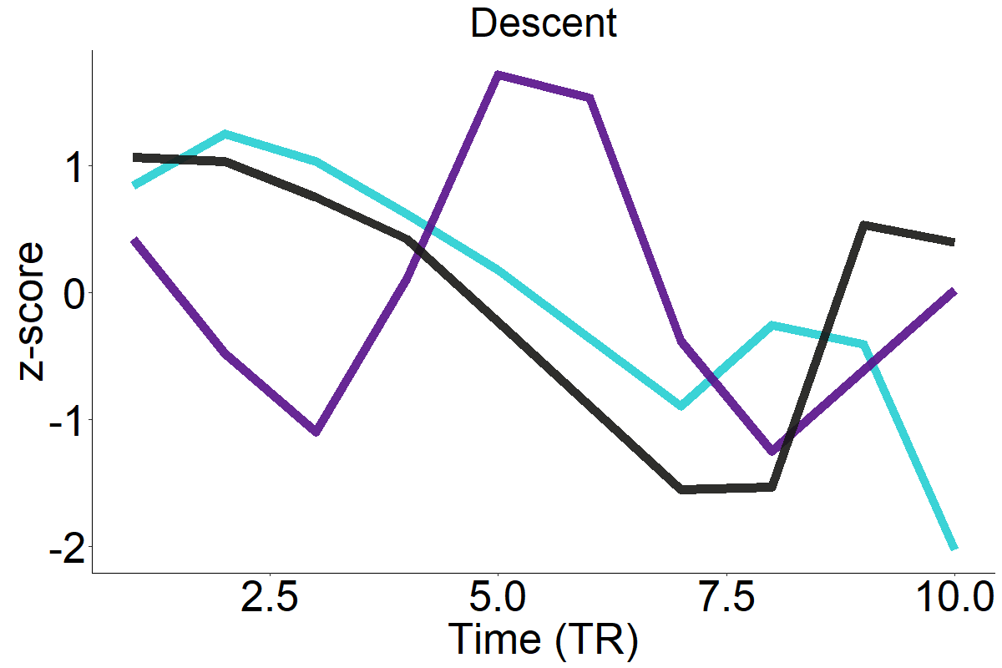
TEMPORAL PCA - PC2
tPC2 – Uncertainty : r = -0.79
tPC2 – Uncertainty : r = -0.04
Young
Old

Slide 21
TEMPORAL PCA
Lower dimensional signature for high uncertainty is evident in older individuals

Slide 22
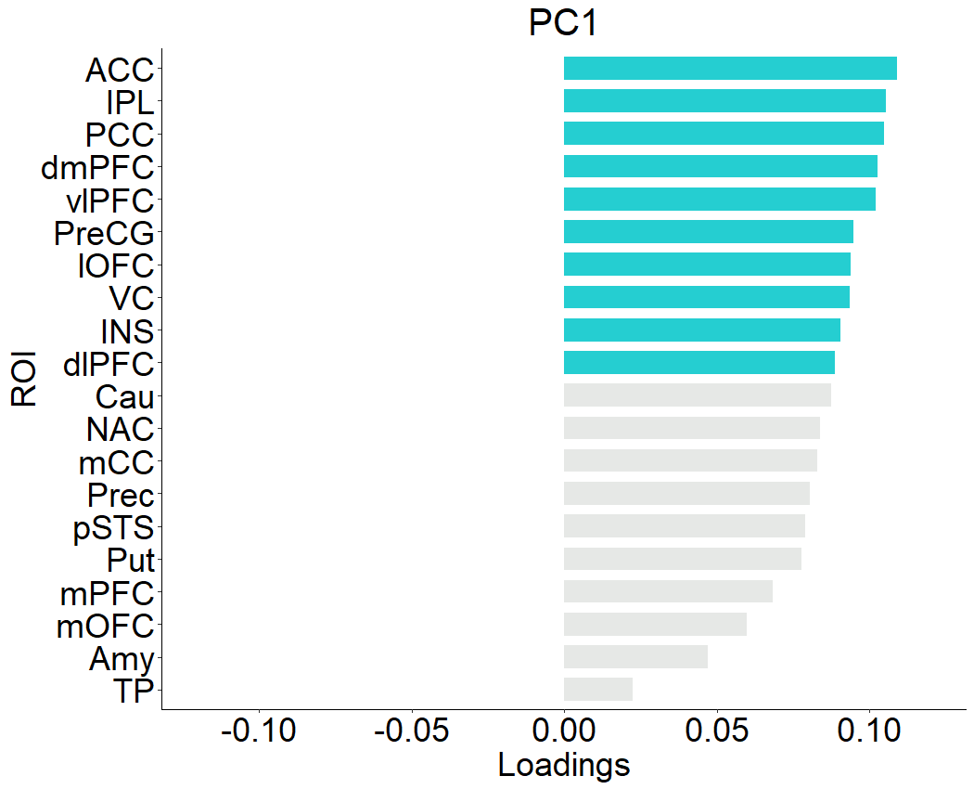
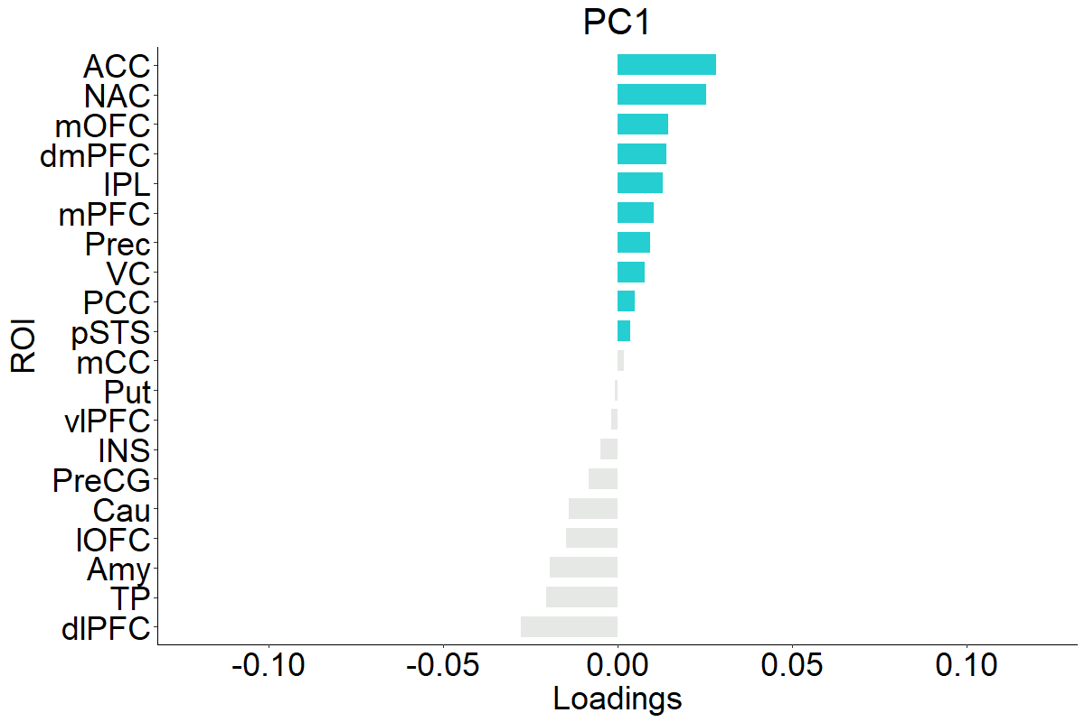
PCA-CONTRIBUTIONS OF THE ROI
Young
Old
The temporal dynamics of uncertainty is mediated by more medial areas in Older individuals compared to the lateral areas in Young

Slide 23
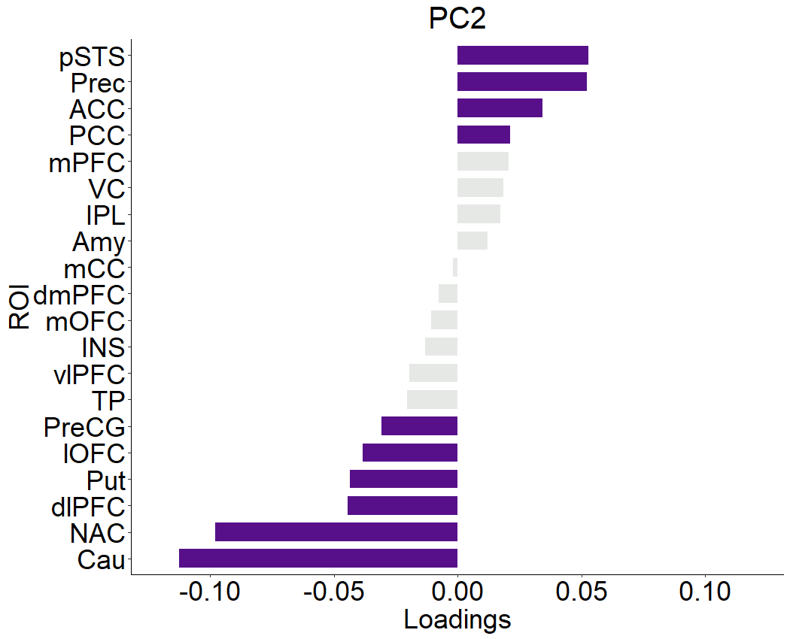
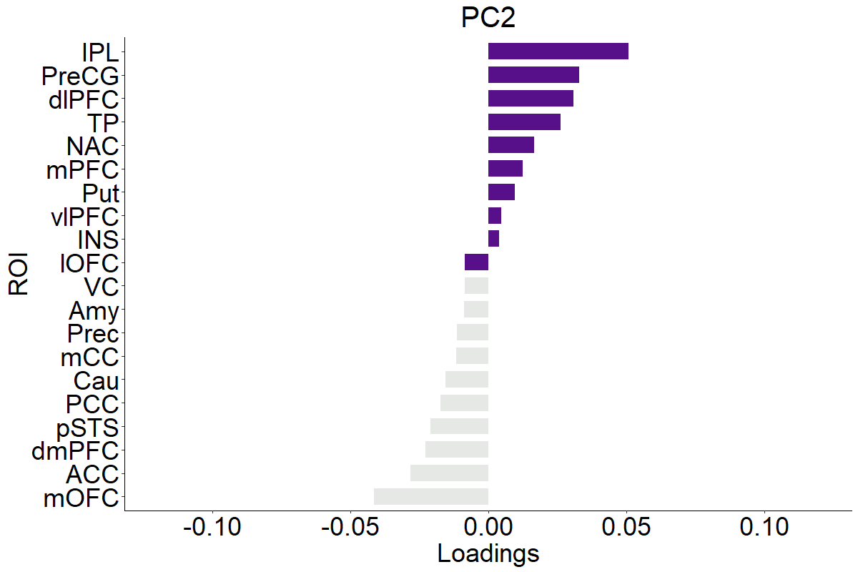
PCA-CONTRIBUTIONS OF THE ROI
Young
Old

Slide 24
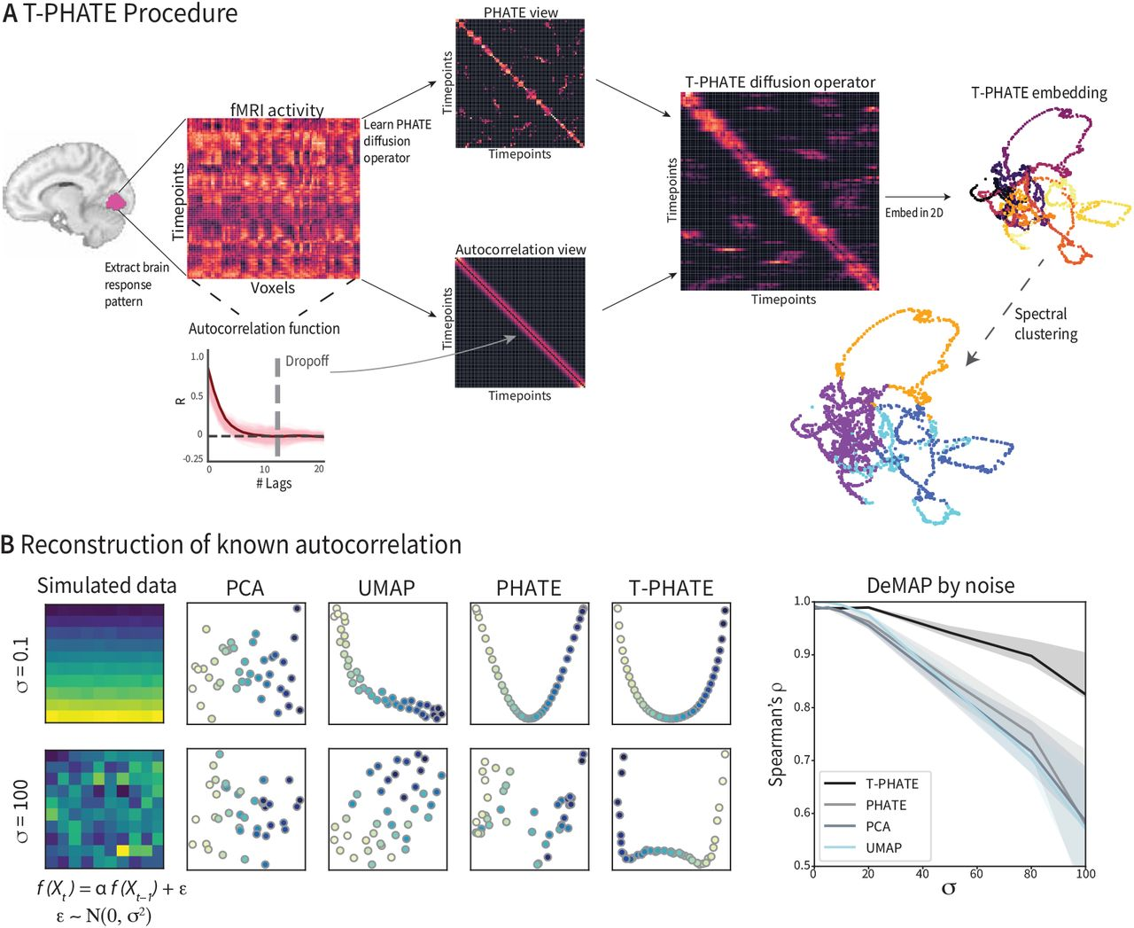
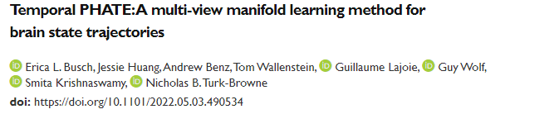
TPHATE

Slide 25
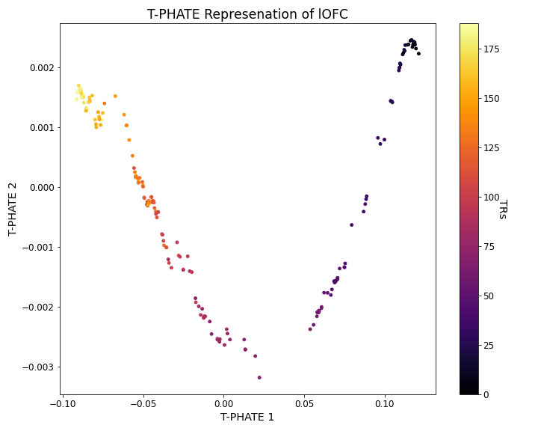
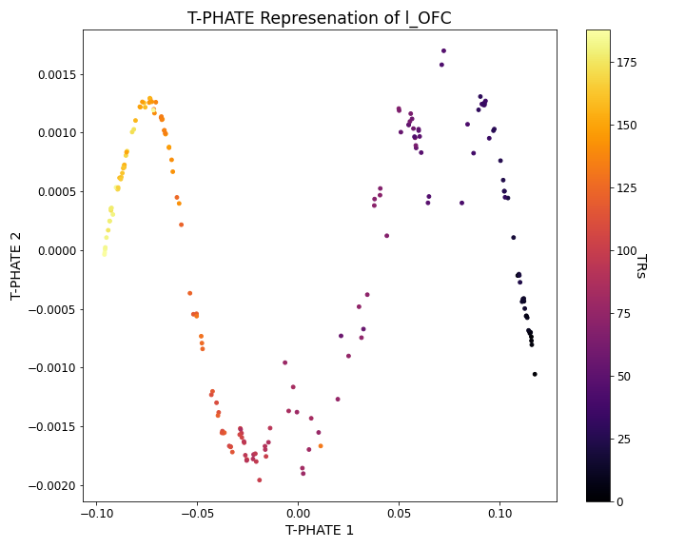
TPHATE
Young
Old
lOFC

Slide 26
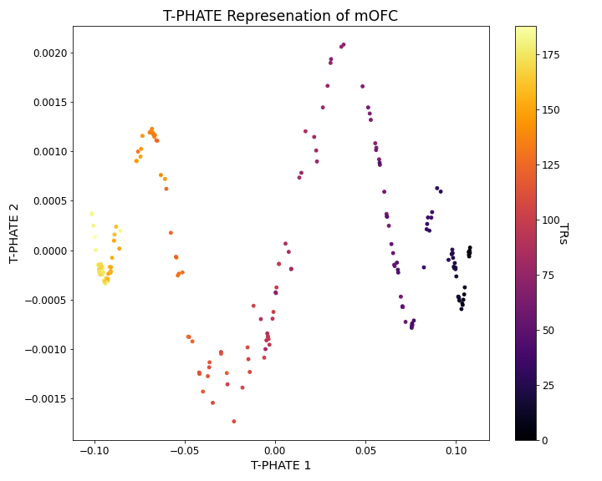
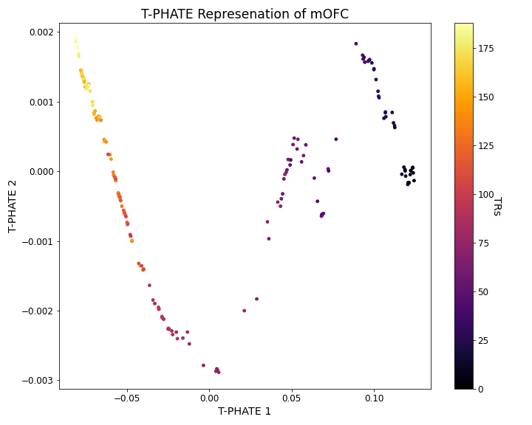
TPHATE
Young
Old
mOFC

Slide 27
TPHATE
lOFC
The low dimensional temporal pattern of lOFC and mOFC in Young and Old almost suggests a switch
Young
Old
mOFC

Slide 28
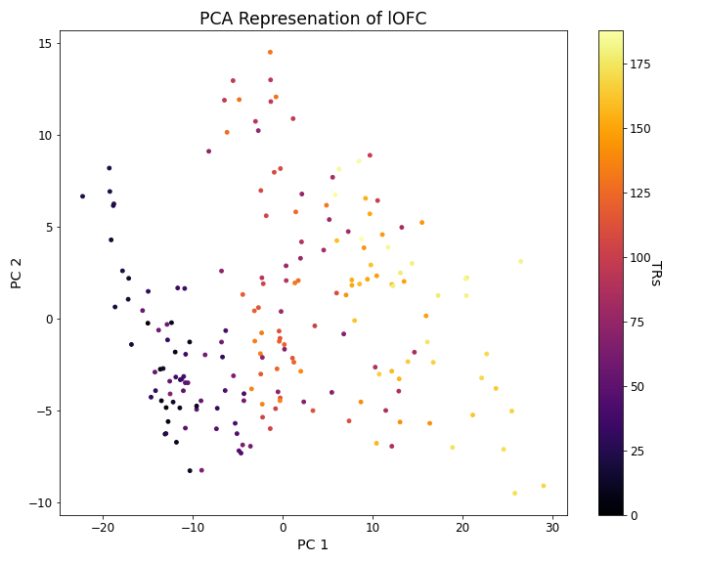
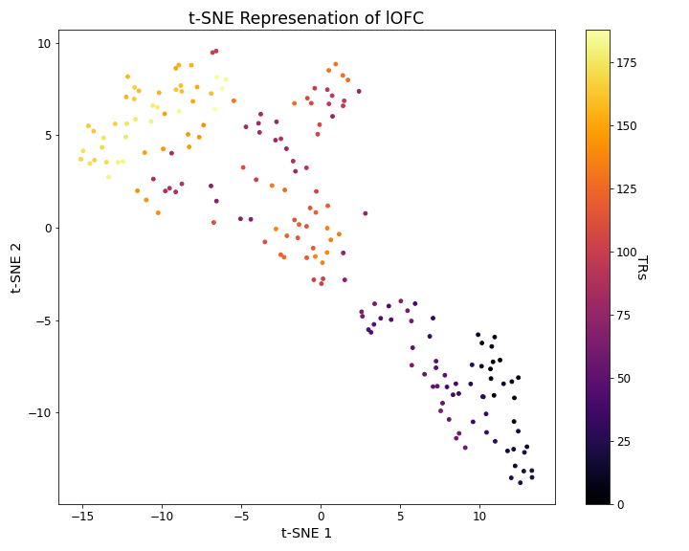
PCA – TSNE – TPHATE
Young

Slide 29
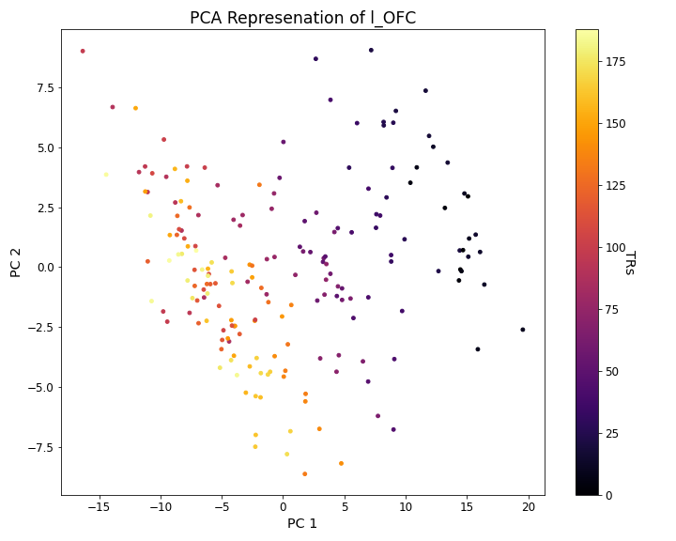
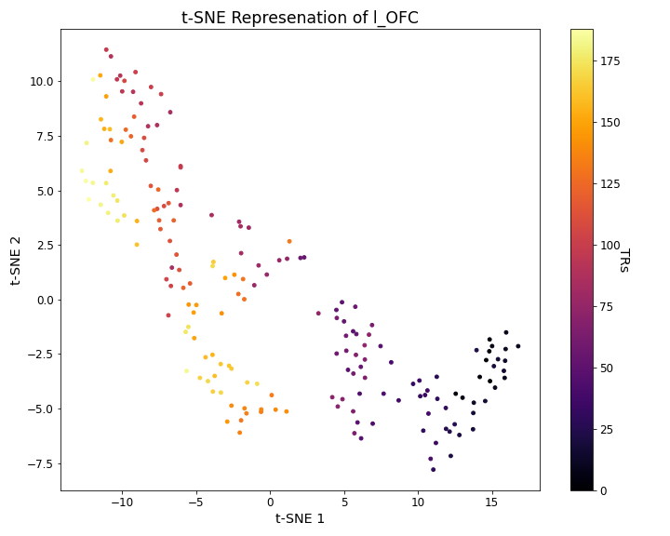
PCA – TSNE – TPHATE
Old

Slide 30
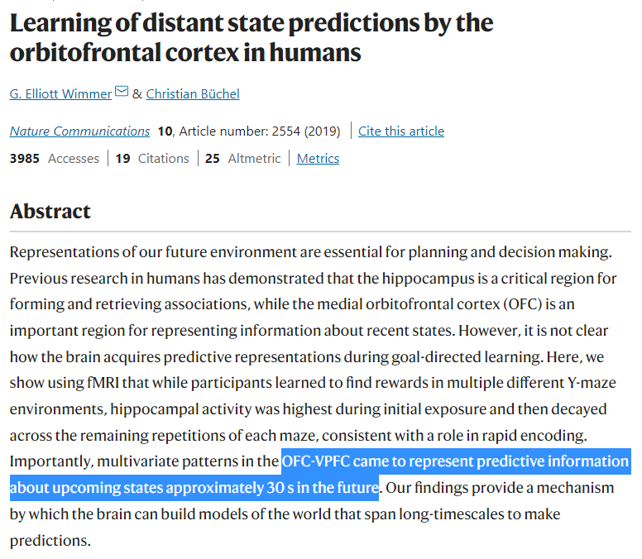
MARR’S LEVEL OF ANALYSIS
Representational level
Computational level
Older individuals have differential representation of uncertainty compared to Young adults
Is this representation indicative of a change in computation of uncertainty?
LSTM
PCA, tSNE, TPHATE

Slide 31
LSTM
How far ahead are we estimating the uncertainty?
Is this different in Young and Old?

Slide 32
LSTM
Training Recurrent Neural Network Family of Models(specifically Long Short-Term Memory) to predict the average BOLD values of all the voxels in each ROI.
s
We prepared the young subjects data by splitting it into 101 training subjects and 10 validation subjects with MinMaxScaling and Reshaping as basic pre-processing steps.
We trained 9 different architectures for each of the 20 ROIs.
We evaluated the models based on their scaled training and validation loss, correlation of the entire actual and prediction BOLD values as well as for the ascent and descent time points on the validation subjects.

Slide 33
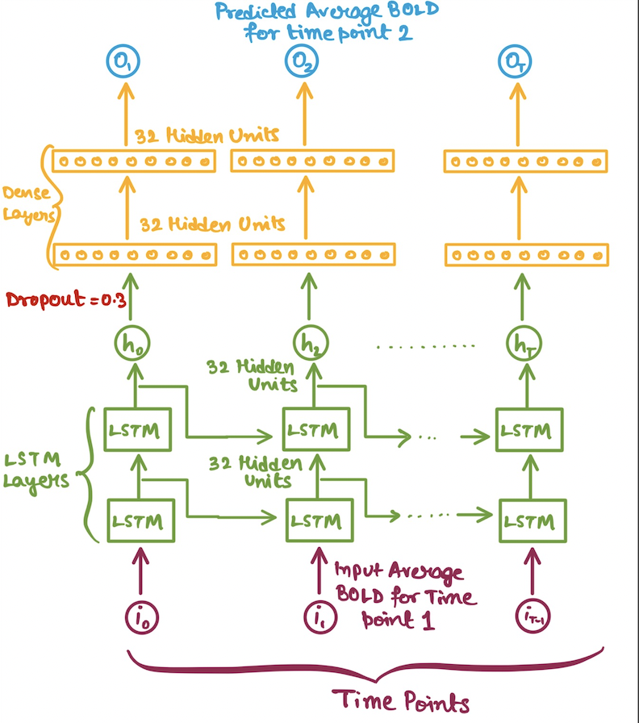
LSTM – MODEL ARCHITECTURE
We have tried several different model architectures by changing number of hidden units, dense layers, LSTM layers, dropouts.
Drawback: Input as an average BOLD so loss of information as all voxels are not equally responsible.
Possible solutions:
Increasing Input Features
Selecting Important Voxels

Slide 34
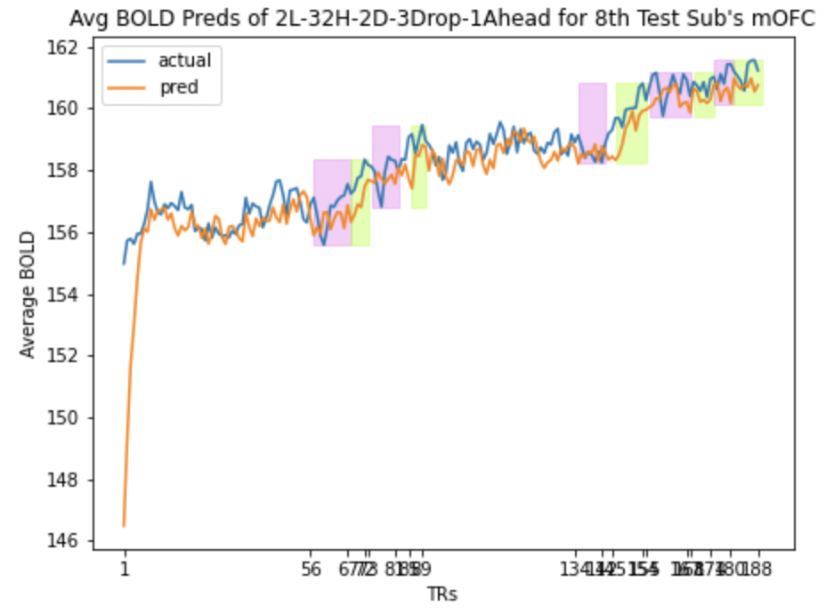
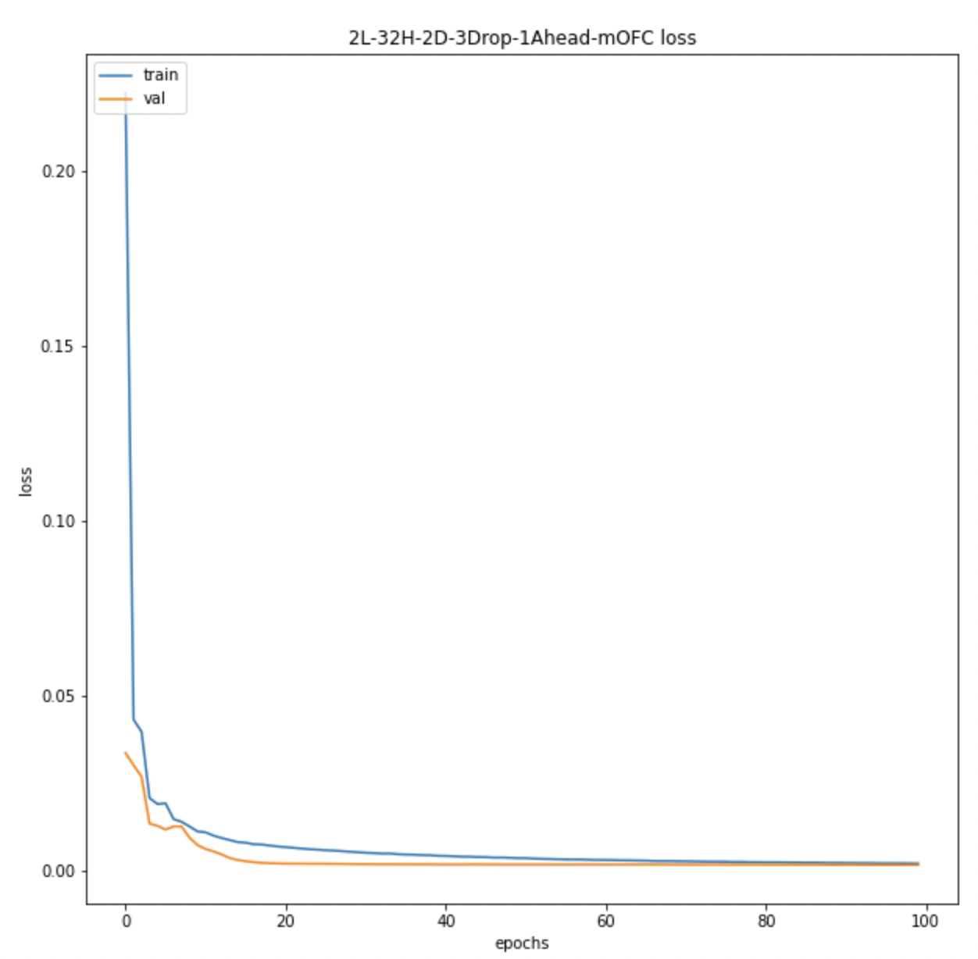
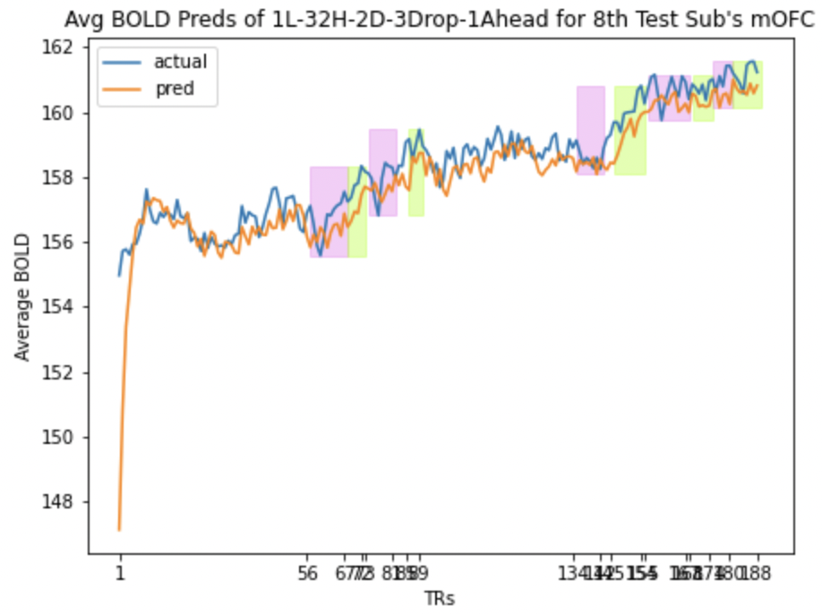
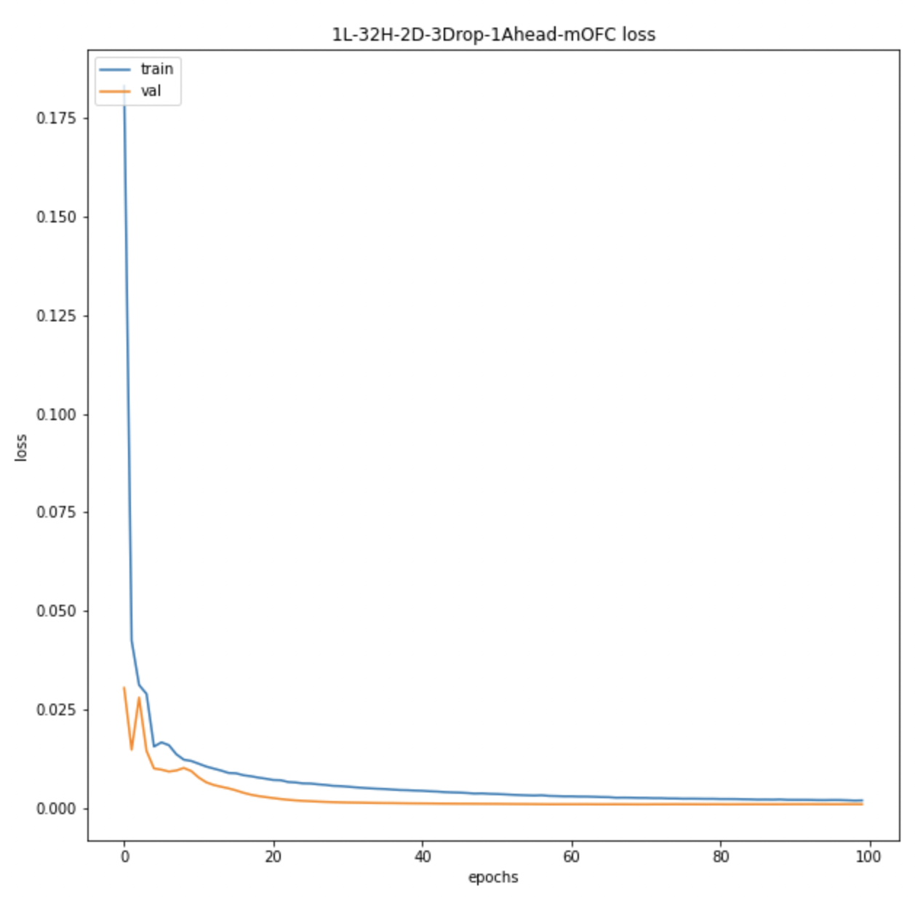
LSTM – MODEL COMPARISON
mOFC average 8th sub corr: 0.9
mOFC scaled training loss: 0.00208
mOFC scaled validation loss: 0.00112
mOFC average 8th sub corr: 0.88
mOFC scaled training loss: 0.00199
mOFC scaled validation loss: 0.00157

Slide 35
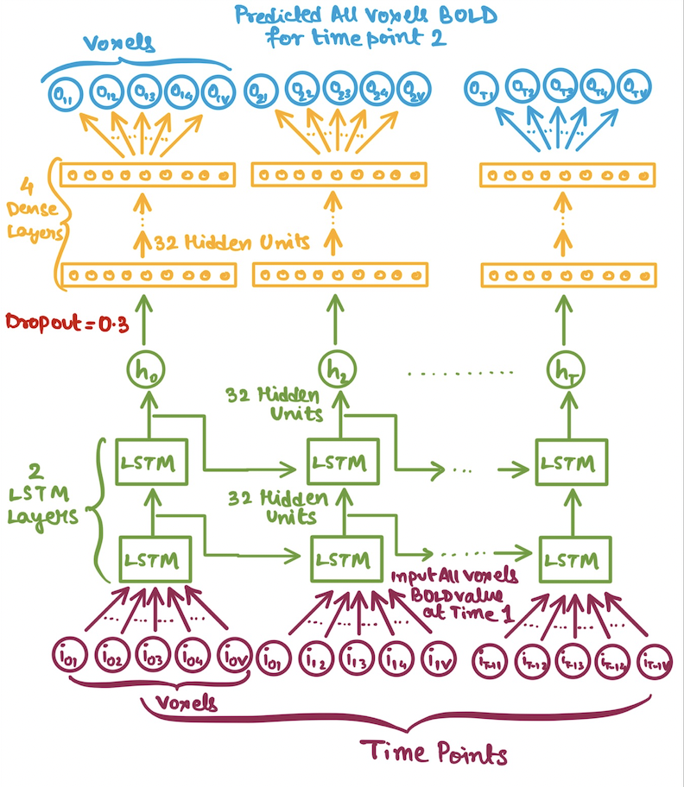
LSTM – MODEL ARCHITECTURE
Drawback: Model output is too big since, each ROI has at least 500 voxel, hence affected by noise.
Possible solutions:
Feature extraction
Maxpooling or combining multiple voxels.

Slide 36
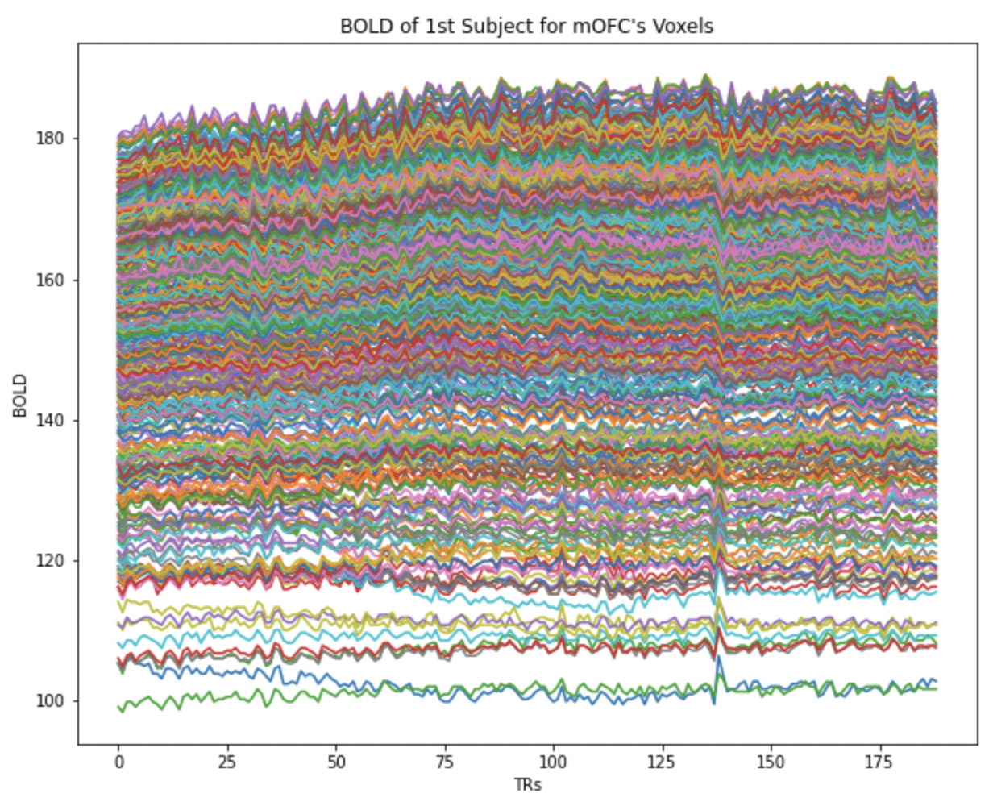
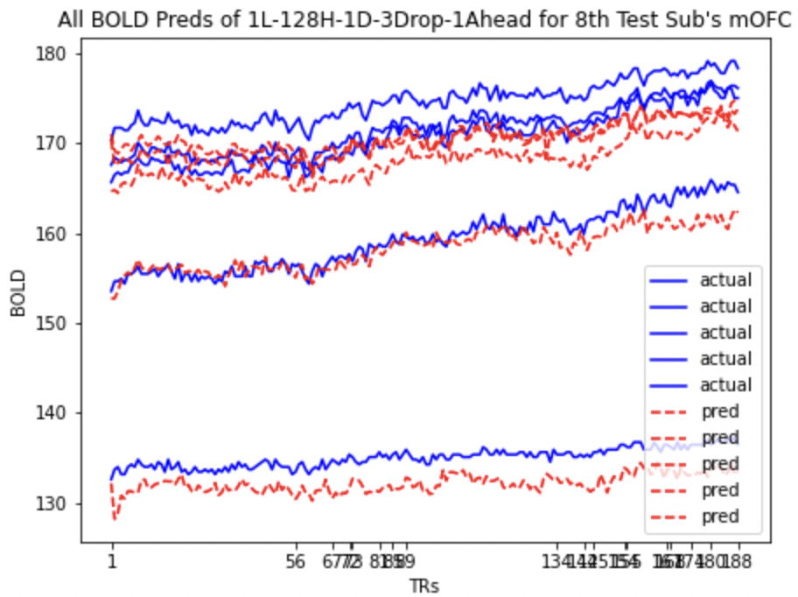
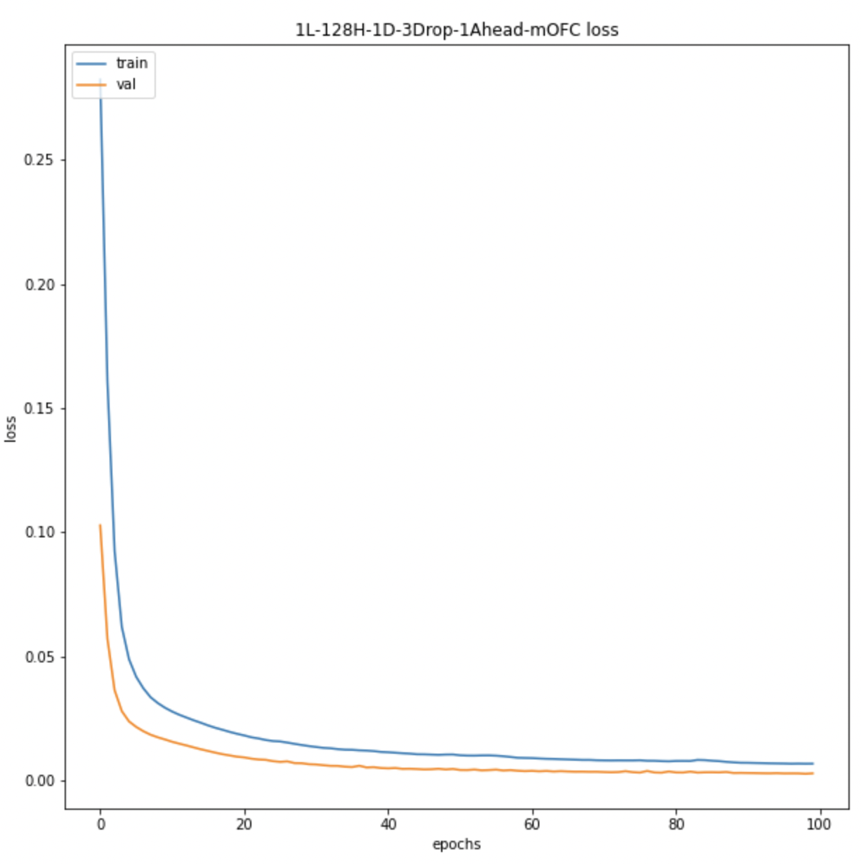
LSTM – MODEL PREDICTIONS
mOFC average 8th subject voxel correlation: 0.77
mOFC scaled training loss: 0.0068
mOFC scaled validation loss: 0.0029
mOFC MSE Loss of 8th Subject: 13.40

Slide 37
WHAT’S NEXT?
Using Masked Attention Based LSTM Model to extract parts of the BOLD time series to which the model pays most attention for BOLD value predictions of the descents.
The current models are trained on young subjects data, so we will be using the selected model for the old subjects to compare the results and accuracy.
Coming to the raised question of how far ahead the young subjects are predicting compared to the old subjects we will train the selected model for 2 TR, 3 TR, …, upto 15 TR ahead prediction and compare the slopes of prediction loss and correlation.
Using Multi-Modality of our data i.e. incorporating Movie frames information along with BOLD values for each ROIs and coming up with a uncertainty map of regions of focus in the movie as well as the ROIs responsible.

Slide 38
THANK YOU
Dr. Dipanjan Roy
Gargi Majumdar(PhD)

